Slide 1


R-Pingmesh: A Service-Aware RoCE Network Monitoring and Diagnostic System
北京邮电大学未来网络实验室与紫金山实验室、字节跳动网络团队, SIGCOMM 2024
Authors：Kefei Liu, Zhuo Jiang, Jiao Zhang, Shixian Guo, Xuan Zhang, Yangyang Bai, Yongbin Dong, Feng Luo, Zhang Zhang, Lei Wang, Xiang Shi, Haohan Xu, Yang Bai, Dongyang Song, Haoran Wei, Bo Li, Yongchen Pan, Tian Pan, and Tao Huang.
汇报人：方如意
日期：2024.11.27
知行合一、经世致用
自强不息 厚德载物
自强不息 厚德载物
Tsinghua University of China
Central South University
Notes:
服务感知的RoCE网络监控和诊断系统

Slide 2
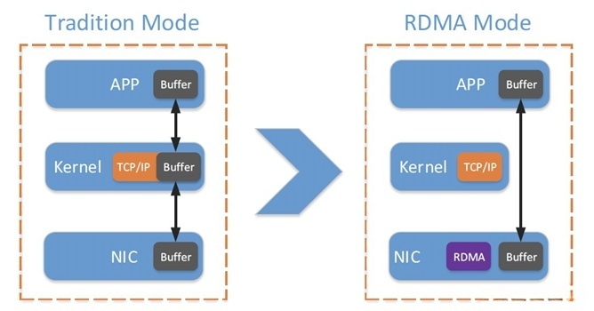
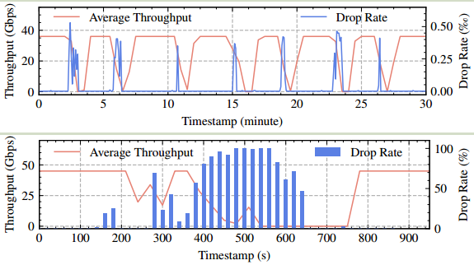
INTRODUCTION
What is RoCE Network?
Data center services have become the core support for high-performance computing and large-scale distributed tasks.
RDMA enables data center services to achieve low latency, high throughput, and low CPU overhead.
RoCE (RDMA over Converged Ethernet) is the most widely adopted RDMA solution in data centers.
Characteristics of RoCE Network Problems
RDMA throughput is sensitive to packet drops
Commodity RDMA NICs (RNICs) use go-back-n as the retransmission mechanism.
Frequent network misconfigurations
RoCE networks typically require a variety of configurations, such as enabling PFC and configuring PFC headroom, leading to a high probability of misconfigurations, which can cause packet drops and throughput degradation.
Frequent RNIC problems
Such as RNIC flapping, which can lead to packet drops and throughput
degradation.
知行合一、经世致用
自强不息 厚德载物
自强不息 厚德载物
Tsinghua University of China
Central South University
Notes:
商品 RDMA NIC（RNIC）使用 go-back-n 作为重传机制。
远程直接内存访问(Remote Direct Memory Access)
RoCE（RDMA over Converged Ethernet）是一种基于以太网的远程直接内存访问协议，旨在通过以太网网络实现高性能、低延迟的数据传输。
文章中提到的 PFC（Priority Flow Control） 配置，是一种在以太网网络中使用的 拥塞管理机制，主要用于减少数据丢包并提升网络传输的可靠性

Slide 3
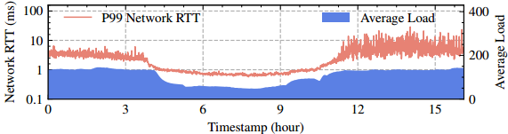
RELATED WORK
Limitations of Existing RoCE Network Monitoring and Diagnostic Mechanisms
1. Hard to detect failures and performance bottlenecks when they occur
Lacking an effective monitoring system for RoCE clusters to:
Quickly detecting packet drops caused by abnormal switches, links, and RNICs.
Accurately monitoring latency metrics, including accurate network RTT and end-host processing delay, to detect performance bottlenecks in end hosts and networks, respectively.
2. Time-consuming to locate network problems in large clusters
Step 1: Inspecting servers and switches for configurations, logs, and anomalous metrics.
Step 2: Running benchmark tools in the cluster (e.g., perftest, nccl-test).This method works for small clusters, but is time consuming for large clusters.
3. Is It a Network Problem?
Service logs can be misleading.
“error code 12 ” problems are caused by:
RNIC down or persistent packet drops on switches. (Network)
Abnormal remote process exit due to GPU down, GPU hang, and GPU out of memory. (non-Network)
知行合一、经世致用
自强不息 厚德载物
自强不息 厚德载物
Tsinghua University of China
Central South University
Notes:
现有 RoCE 网络监控和诊断机制的局限性
步骤 1：检查服务器和交换机的配置、日志和异常指标。
步骤 2：在集群中运行基准测试工具（例如 perftest、nccl-test）。此方法适用于小型集群，但对于大型集群来说很耗时。
Benchmark: 基准

Slide 4
Motivation
Design Targets
1. Detect problems specific to RoCE networks.
Need to use RoCE packets for network probing.
2. Distinguish between RNIC and in-network drops.
To accurately locate anomalous RNICs, switches, or links, need to accurately tell if a dropped probe is caused by an RNIC or a switch.
3. Accurately measure end-host processing delay and service network RTT.
Accurate measurement of end-host processing delay and service path RTT is essential to locate performance bottlenecks.
4. Assess the impact of problems on services (Service-Aware).
Prioritize each detected problem based on its impact:
P0: Severe impact; must be resolved immediately.
P1: Minor impact; fix based on benefit.
P2: Not service-related; no action needed.
Insight: If no P0/P1 problems are detected when service performance degrades, the network is innocent.
知行合一、经世致用
自强不息 厚德载物
自强不息 厚德载物
Tsinghua University of China
Central South University
Notes:
如果服务性能下降时没有检测到 P0/P1 问题，则网络是无问题的。

Slide 5
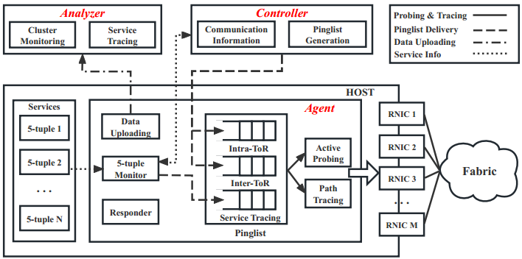
R-Pingmesh Design
Two Independent Functions
Function 1: Cluster Network Monitoring
Construct RoCE packets to probe between all RNICs in a RoCE cluster.
Monitor network SLAs of RoCE clusters: Connectivity, drop rate, RTT, and processing delay.
Service-Independent: Able to detect network problems before services run.
Function 2: Service Tracing Probing
Similar to Function 1 in the probing data path.
Differences from Function 1:Probe paths used by services.
Accurately detect and locate problems in the service network.
Monitor service network SLAs: Connectivity, drop rate, RTT, and processing delay.
Service-Aware: Assess the impact of detected problems on services.
R-Pingmesh has three modules: Agent, Controller, and Analyzer
知行合一、经世致用
自强不息 厚德载物
自强不息 厚德载物
Tsinghua University of China
Central South University

Slide 6
R-Pingmesh Design
R-Pingmesh Controller
1. Store the latest RNIC communication information.
GID (Global Identifier) and QPN (Queue Pair Number), similar to IP and port number.
QPN can only be obtained after Agent starts and creates a QP on the RNIC.
2. Create ToR-mesh and inter-ToR pinglists for each RNIC in Cluster Monitoring.
Pinglists include the target RNIC's latest communication information.
ToR-mesh probing: Probe within ToR switches and monitor RNIC states.
Inter-ToR probing: Cover all network links between different ToR switches.
知行合一、经世致用
自强不息 厚德载物
自强不息 厚德载物
Tsinghua University of China
Central South University

Slide 7
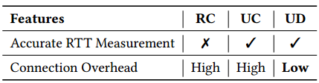
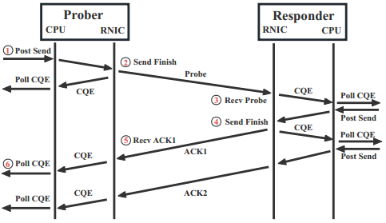
R-Pingmesh Design
R-Pingmesh Agent - (1) Measure Network RTT and Processing Delay
Choice of QP type: UD!
All three QP types can obtain timestamps ③ and ⑤ from receive CQEs.
In RC, he sender RNIC generates a CQE only after receiving ACKs for all message packets sent to the destination.
In UC and UD, the sender RNIC generates a CQE immediately after the message is sent to the network, without waiting for ACKs, allowing timestamps ② and ④ to be obtained.
2. For accurate measurement:
Network RTT: (⑤−②)−(④−③).
Prober processing delay: (⑥−①)−(⑤−②).
Responder processing delay: (④−③).
All duration calculations (⑤−②, ④−③, and ⑥−①) do not require clock synchronization between the host CPU and the RNIC or between the prober and the responder.
知行合一、经世致用
自强不息 厚德载物
自强不息 厚德载物
Tsinghua University of China
Central South University
Notes:
UD（Unreliable Datagram）

Slide 8
R-Pingmesh Design
R-Pingmesh Agent - (2) Monitor and Probe the 5-tuple of Service
Use eBPF to trace the call to the kernel functions modify_qp and destroy_qp.
When the service connects QPs on two RNICs: It calls modify_qp to modify the QP attribute, including the connection 5-tuple.
When the service closes a connection, it calls destroy_qp.
By tracing these two verbs, the Agent can keep track of the 5-tuple used by services in real-time.
Construct probes with the same 5-tuple as the service flows. These probes can cover the exact network paths used by the service due to ECMP hashing.
R-Pingmesh Agent - (3) Path Tracing
Periodically traceroute the latest paths of probe packets and their ACKs. (VS: Track only when you encounter network problems)
Continuous Path Tracing instead of path tracing when detecting anomalies.
In the case of a persistent failure (e.g., link failure), the replayed dropped packets will be rehashed to other normal links, leading to inaccurate fault inference.
Continuous path tracing allows the Analyzer to locate network problems immediately as they occur.
知行合一、经世致用
自强不息 厚德载物
自强不息 厚德载物
Tsinghua University of China
Central South University
Notes:
在网络发生持续性故障（如链路故障）的情况下，原本通过该链路传输的数据包可能会被网络重新分配（rehashed）到其他正常的链路上继续传输。由于这种重新分配机制，可能导致网络诊断工具无法准确定位原始故障的具体位置，从而产生错误的故障推断（fault inference）。
ECMP（Equal-Cost Multi-Path） 是一种路由策略，用于在多条具有相同开销的路径之间分摊网络流量

Slide 9

R-Pingmesh Design
R-Pingmesh Analyzer - (1) Use ToR-mesh Probing to Detect Anomalous RNICs
1. Timeout and high RTT are two types of abnormal data in the uploaded end-to-end detection results：
High RTT: usually caused by network problems (such as network congestion).
Timeout: may be caused by the following reasons:
Network problems: such as flapping of ports RNICs or Switches.
Non-network problems: such as host downtime.
(First check if the Agent on the target host is still uploading data. If not, the timeout is caused by a host crash.)
Probe noise: such as QPN reset.
(The analyzer compares the QPN of the target RNIC in the probe packet with the QPN stored in the controller. If the two do not match, the timeout is caused by a QPN reset.)
2. ToR-mesh Probing: Introduces minimal uncertainty:
Probing under a ToR switch involves only two links.
If a probe from RNIC A to RNIC B shows anomalies, the problem is either at A, B, or the ToR switch.
3. Identification of Anomalous RNICs:
Multiple probes showing anomalies for the same RNIC indicate that the RNIC is likely abnormal.
知行合一、经世致用
自强不息 厚德载物
自强不息 厚德载物
Tsinghua University of China
Central South University
Notes:
同时，不应使用任何涉及RNIC的异常探测数据来定位交换机网络问题。这种方法的前提是，对于每个RNIC，在同一ToR交换机下，在一段细粒度的时间内，应该有足够的来自其他RNIC的探测，以便我们可以实时监视每个RNIC的状态。

Slide 10
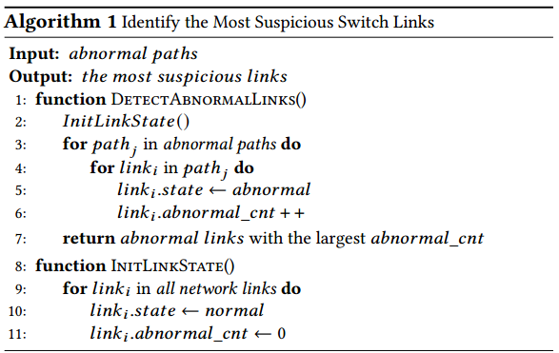
R-Pingmesh Design
R-Pingmesh Analyzer - (2) Locate Switch Network Problems
Filtering Anomalous Probes:
After detecting anomalous RNICs and filtering out probes caused by them, only anomalous probes caused by switches remain.
2. Simple Voting Algorithm:
The analyzer uses a voting algorithm to infer abnormal devices.
It traverses the paths of probes and their ACKs, counting the number of times each link or switch is traversed.
3. Result:
The link or switch with the highest number of votes is identified as the most suspicious.
知行合一、经世致用
自强不息 厚德载物
自强不息 厚德载物
Tsinghua University of China
Central South University
Notes:
当Analyzer检测到交换机网络问题导致的异常探针上传数量超过阈值时，将逐个遍历这些探针及其ack的路径，并统计每条链路的遍历次数。经过这个过程，票数最高的链接是最可疑的。

Slide 11
R-Pingmesh Design
R-Pingmesh Analyzer - (3) Assess the Impact of Problems on Services (Service-Aware)
1. If a problem is detected by Service Tracing:
This problem can affect the service (P0 or P1):
P0: The performance degradation exceeds the preset threshold, and the problem should be fixed immediately.
P1: Otherwise, the decision to fix the problem should be based on the benefits gained after resolution.
2. If a problem is detected by Cluster Monitoring but not by Service Tracing:
This problem is outside the service network and does not affect service performance (P2).
3. If service performance degrades but Service Tracing Probing does not find any problem:
The service network is considered innocent.
知行合一、经世致用
自强不息 厚德载物
自强不息 厚德载物
Tsinghua University of China
Central South University

Slide 12
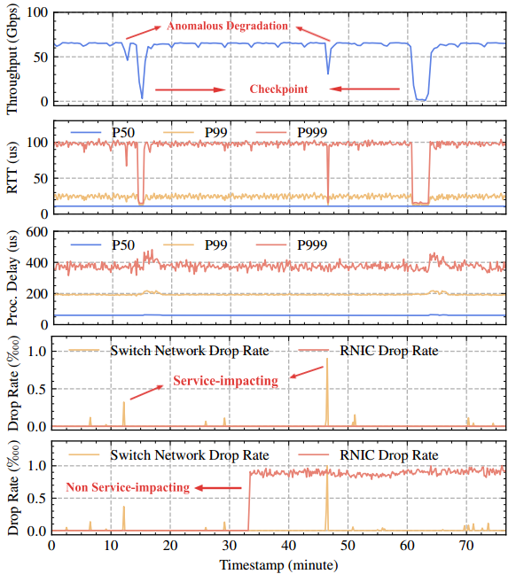
Evaluation
Accurately measure RTT and processing delay and use them to reflect service states.
R-Pingmesh was deployed for over 6 months on multiple DML RoCE clusters:
Tens of thousands of RDMA NICs were used in total.
Including both on-premises and public cloud clusters.
The performance of R-Pingmesh was evaluated on a large-scale DML cluster:
3 tiers of switches were used to accommodate thousands of GPU servers.
The switches were equipped with Broadcom Tomahawk 4 chips, each providing 64 × 400 Gbps ports for a total bandwidth of 25.6 Tbps.
The oversubscription ratio at each tier was 1:1 (32 ports for downlink and 32 ports for uplink).
Service
Tracing
Cluster
Monitoring
Measured network RTT has the same "shape" with average training throughput.
知行合一、经世致用
自强不息 厚德载物
自强不息 厚德载物
Tsinghua University of China
Central South University
Notes:
我们在多个 DML RoCE 集群上部署了 R-Pingmesh 超过 6 个月。
总计使用了数万块 RDMA NIC。
包括本地部署集群和公共云集群。
我们在一个大规模 DML 集群上评估了 R-Pingmesh 的性能。
使用了三层交换机架构，支持数千台 GPU 服务器。
不同层的交换机通过类似 Clos 的拓扑结构互联。
交换机采用了Broadcom Tomahawk 4 芯片，每台交换机有 64 个 400 Gbps 端口，总带宽达到 25.6 Tbps。
每层交换机的超订阅比为 1:1（32 个端口用于下行连接，32 个端口用于上行连接）。

Slide 13
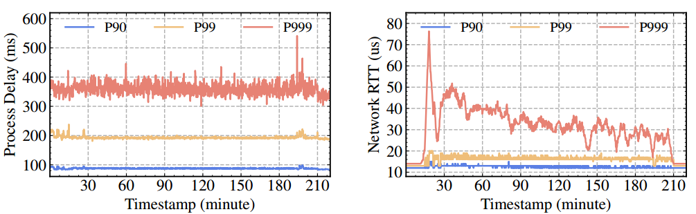
Evaluation
Effectively determine if the network is to blame when service performance degrades.
Service throughput continues to degrade due to bugs in the training code.
No anomaly found in processing delay
Measured network RTT continues to decrease
知行合一、经世致用
自强不息 厚德载物
自强不息 厚德载物
Tsinghua University of China
Central South University

Slide 14
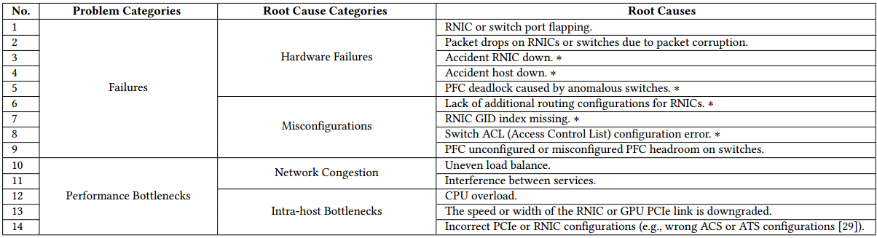
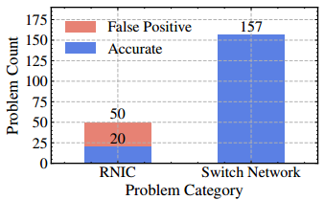
Evaluation
Problems Found by R-Pingmesh
Efficiently detect and locate 14 types of problems caused by hardware failures, misconfigurations, network congestion, and intra-host bottlenecks during deployment.
Data Source: Data from a recent month in the DML cluster was used to evaluate the localization accuracy of R-Pingmesh.
R-Pingmesh detected and located 207 problems during this month.
Switch Network Problems: 85% of reported problems are accurate.
RNIC Problems: Out of 50 reported RNIC problems, only 20 are confirmed.
知行合一、经世致用
自强不息 厚德载物
自强不息 厚德载物
Tsinghua University of China
Central South University

Slide 15
Thanks！

